Slide 1
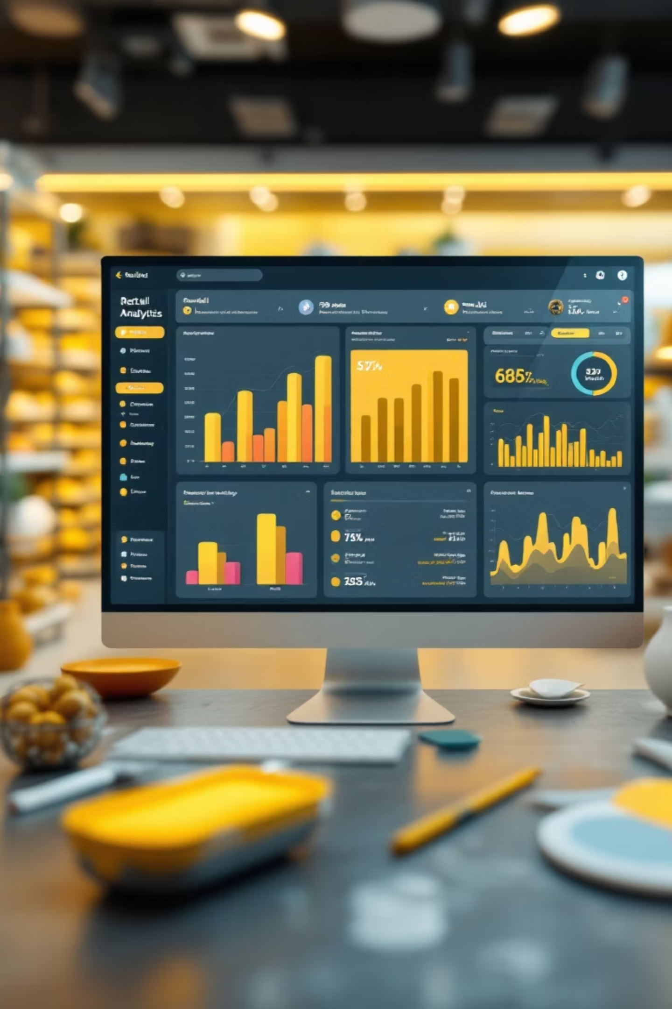
Customer Shopping Behavior Analysis
Uncovering insights from 3,900 purchases to guide strategic business decisions

Slide 2

DATASET OVERVIEW
The Foundation
3,900
18
37
Total Purchases
Data Points
Missing Values
Transactions analyzed across all categories
Features per customer transaction
Only in Review Rating column
Key features include customer demographics, purchase details, and shopping behavior patterns

Slide 3






PYTHON ANALYSIS
Data Preparation Pipeline
Data Loading
Imported dataset using pandas
Exploration
Structure check and summary statistics
Cleaning
Imputed missing values, standardized columns
Feature Engineering
Created age groups and purchase frequency metrics

Slide 4

SQL INSIGHTS
Revenue by Gender
Key Finding
Male customers generated $1.23M in revenue
Female customers generated $1.19M in revenue
Nearly balanced contribution across genders

Slide 5

High-Value Discount Users
Strategic Insight
Identified customers who used discounts but spent above average
These shoppers combine price sensitivity with high purchase values
Business Opportunity
Target this segment with premium product bundles
Optimize discount strategy to maintain margins

Slide 6



TOP RATED
Product Excellence
Blouse
Jewelry
Dress
Highest rated product
Exceptional customer satisfaction
Consistently high reviews
These top-rated products drive customer satisfaction and repeat purchases

Slide 7

Shipping & Subscription Insights
Shipping Type Impact
Subscription Power
Express: $60.12 avg purchase
Subscribers: Higher average spend and loyalty
Standard: $59.76 avg purchase
Non-subscribers: Lower engagement
Minimal difference suggests price isn't the primary driver
Subscription status strongly correlates with customer value

Slide 8



CUSTOMER SEGMENTS
Understanding Customer Loyalty
Loyal
Returning
New
Customer segmentation based on purchase history reveals clear loyalty tiers
Key Finding
Customers with 5+ purchases show significantly higher subscription rates

Slide 9

POWER BI DASHBOARD
Interactive Analytics
Visual Insights
Dynamic Filtering
Actionable Metrics
Real-time data exploration
Drill down by segment
KPIs at a glance

Slide 10
RECOMMENDATIONS
Strategic Action Plan
01
02
03
Boost Subscriptions
Loyalty Programs
Review Discount Policy
Promote exclusive benefits and rewards for subscribers
Reward repeat buyers to move them into "Loyal" segment
Balance sales growth with margin control
04
05
Product Positioning
Targeted Marketing
Highlight top-rated products in marketing campaigns
Focus on high-revenue age groups and express-shipping users

